Slide 1

Diagnosing Diabetes
Diabetes probability based on behavioral, medical, demographic and economic factors
Team 29: Olivia Watson, Selda Kocaman, Kelly Cristina Ribiero Yogui, Thu Thi Diem Le, Hande Pehlivan

Slide 2


Diabetes is stealing our lives, wellbeing, and money
Nearly 10% of Americans have type II diabetes
Diabetes takes ~10 years off someone’s life
Diabetes is a major cause of blindness, kidney failure, heart attacks, stroke and lower limb amputation
Diabetes reduces a person’s productivity
Diabetes costs the United States over $325 billion dollars a year
Diabetes care represents 1 in 4 U.S. healthcare dollars
A citizen with diabetes can expect to pay nearly $10,000 a year for diabetes related healthcare

Slide 3
Catching and curing diabetes creates significant cost savings and revenue potential
NINETY BILLION DOLLARS
The amount the private sector could save per year on improved productivity, reduced absenteeism, and reduced insurance costs.
SEVENTY FIVE + BILLION DOLLARS
The amount new entrants could steal from the current diabetes market.

Slide 4
Our Project: To identify the factors impacting the likelihood to be diagnosed with diabetes

Slide 5

Detailed Approach
DESK RESEARCH & DATA SOURCING
1
We have read and taken notes on a number of academic research studies including those from Venkat Narayan and other leading researchers in the diabetes field.
DATA PROCESSING & CLEANING
2
We have uploaded and inspected the missing data. We have researched how to handle missing data with medical survey responses and will remove rather than manipulate missing values. We have merged the two data sets on state and year.
FEATURE SELECTION
3
Our desk research, available data after cleaning, correlation charts, ridge and stepwise have led us to include variables related to obesity, diet, exercise, and cost of living for initial modeling.
MODEL COMPARISON & MODEL SELECTION
4
We will run Logistic Regression, KNN, Random Forest, and SVM with cross-validation and compare the cross-validation accuracy results. From there, we will choose the model with the best accuracy score.
ANALYSIS
5
We will create charts, analyze results, and potentially conduct further desk research to better understand the data and any current research that supports the findings.

Slide 6
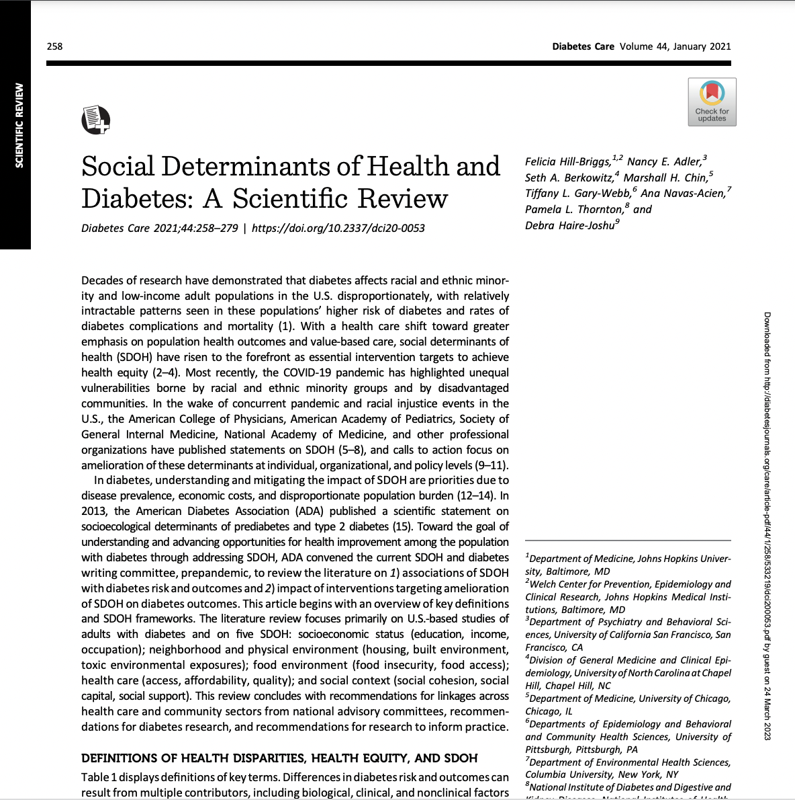
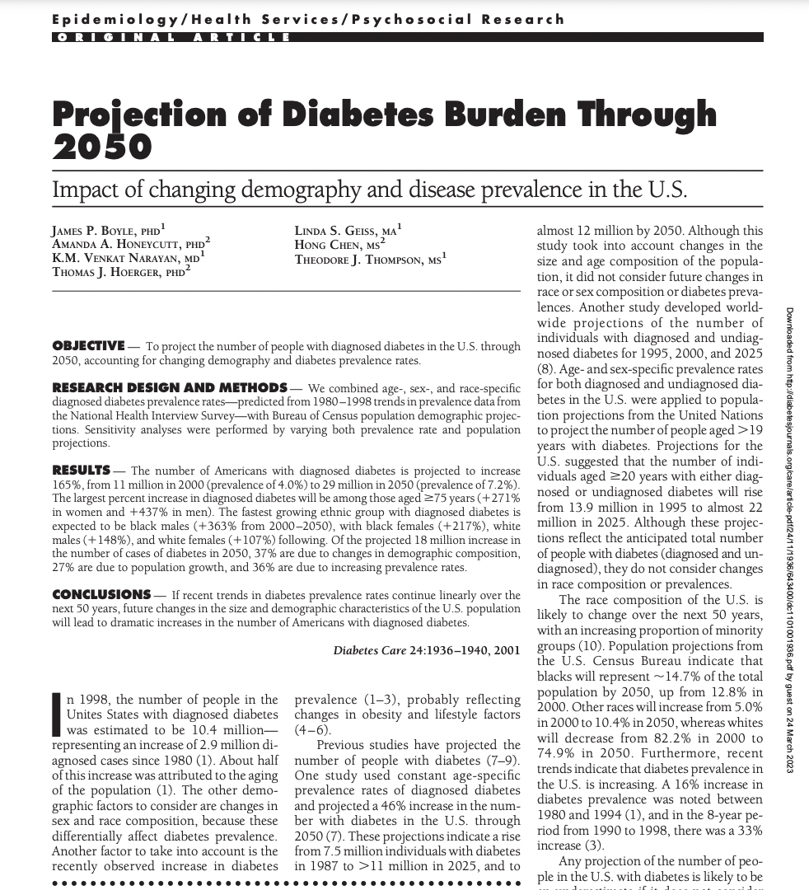
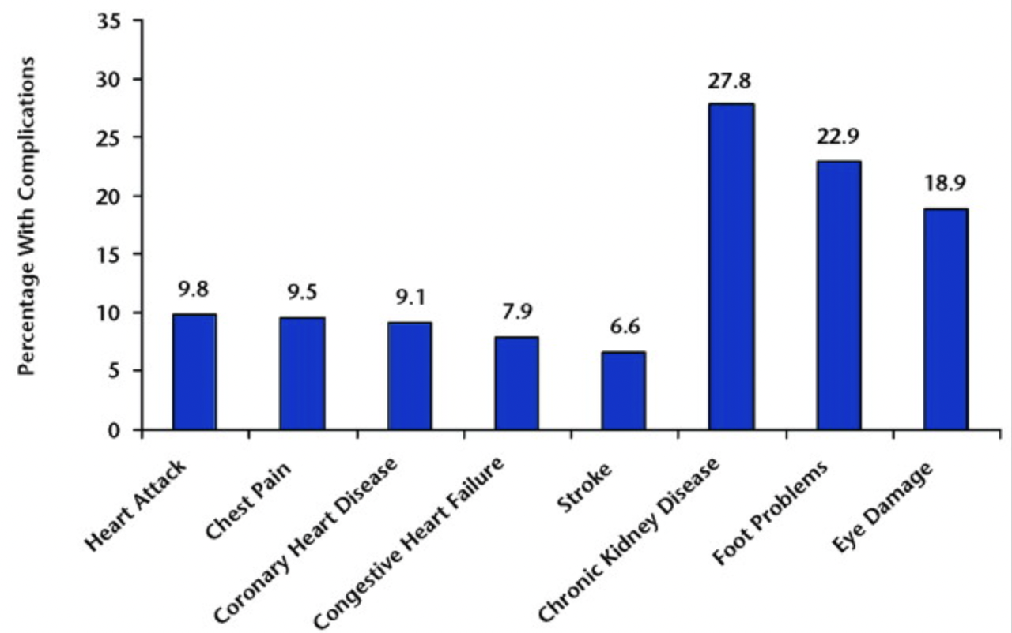
Our desk research informed our data selection
Research & Data Sourcing
Desk Research:
Social Determinants of Health & Diabetes
Projection of Diabetes Burden Through 2050
Epidemiology of Diabetes and Diabetes-Related Complications
Data Sourcing:
Desk research led us to look for data that included race, education, and presence of other diseases/complications
Prevalence of diabetes related complications among people with diabetes

Slide 7
Our multiple data sources required extensive cleaning before merging
Data Processing & Cleaning
DATA
CLEANING
Behavioral Risk Factor Surveillance System
1
Codebook Review
Survey data captured through phone interviews across all 50 states
Captures behavioral, medical, and demographic data
2
Identifying & removing missing values
3
Variable transformation for ease of analysis
Cost of Living Index
Indexed cost of living data from the United States
Grocery, housing, utilities, transportation, and health costs
4
Data Merging on ‘State’ and ‘Year’ columns
CONTINUED ON NEXT SLIDE
5
Feature Reduction
US Populations by State
This data source includes the 2022 population per state, growth, and density per miles, later used to calculate diabetes density

Slide 8
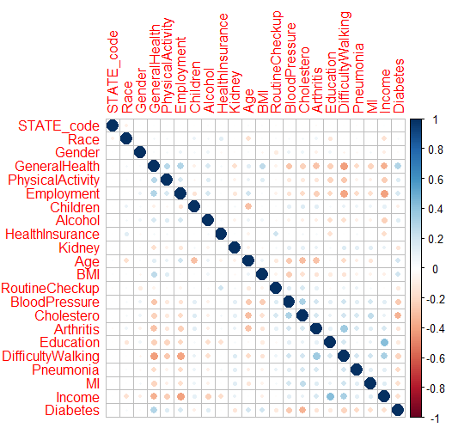
Lasso, PCA, multicollinearity, correlation, and literature review informed final variable selection
Feature Selection
Lasso & PCA
Correlation
Lasso & PCA reduced variables by 2/3.
We checked for correlation above .7, and removed compounding variables (ie removed weight in kilograms to keep BMI).
Multicollinearity
Lit review
We checked multicollinearity using functions outlined in class.
Our lit review solidified certain variable inclusion, like BMI, cholesterol, and race among others.
Correlation Matrix
None of the pairs of predictors is significantly correlated after variable reduction.
FINAL DATA SET
Our final dataset was reduced from 438,693 rows and 303 columns to 134,702 rows and 22 columns. The final variables include state, race, gender, general health, physical activity, employment, cholesterol medicine, kidney disease, health insurance, BMI, age, blood pressure, education, and income, among others.

Slide 9

Though all models have passable accuracy, our models lack precision
Model Comparison & Selection
Post Up-Sampling
Model | Accuracy | Sensitivity | Specificity | Precision | Recall | AUC
Logistic Regression | 0.716 | 0.834 | 0.698 | 0.29 | 0.834 | 0.848
KNN | 0.817 | 0.897 | 0.805 | 0.405 | 0.897 | 0.851
Decision-Tree | 0.856 | 0.328 | 0.934 | 0.424 | 0.328 | 0.63
Naïve Bayes | 0.787 | 0.658 | 0.806 | 0.334 | 0.658 | 0.732
To predict someone’s likelihood of being diagnosed with diabetes, we scale the data where necessary, split the data into test and training sets, and compare classification models.
KNN is the best performing model overall. However, Decision-Tree has the highest precision scores, which measures the accuracy of positive predictions. Logistic Regression has high sensitivity and ease of interpretation for stakeholders.
After initial modeling, up-sampling was required to balance the data and improve scores.
Unfortunately, all models’ precision scores are below .5, indicating more work need be done to use and trust the model to predict presence of diabetes.

Slide 10
Logistic regression validates hypotheses on BMI, general health, & co-morbidities
Initial Analysis
While not yet the most accurate model, logistic regression reveals variable level insights that can be more digestible and actionable for new entrants than KNN or Decision tree results
Significant variables include: state, race, gender, employment, children at home, alcohol consumption, kidney disease, age, last routine checkup, blood pressure, arthritis, pneumonia, and income
BMI
General Health
Cholesterol Meds
The predicted odds of having diabetes is 1.5 times higher as someone goes from overweight to obese.
Maintaining a normal BMI range may reduce a person’s likelihood of being diagnoses.
The predicted odds of having diabetes increases by 80% as a person reports worse health (excellent, very good, good, fair, poor).
A person’s self reported general health may be a key indicator in segmenting.
The predicted odds of having diabetes decreases by nearly half if someone is not taking medicine for high cholesterol.
Cholesterol medication is often prescribed for those at risk for stroke and heart attack, co-morbidities of diabetes.

Slide 11



Further transformation of the diabetes variable is required
Next Steps
ACTUAL VALUES
0
1
Our selected model, KNN, has high recall, F1, AUC and less Type II error, with sensitivity and recall at 89.7%
18,894
TN
359 FN
0
PREDICTED VALUES
KNN has high Type I error. Only 40.5 % of the correctly predicted cases are actually positive.
4575
FP
3113
TP
1
Further transformation using logs or other models may improve our precision.
It’s critical to avoid misclassification so as not to overwhelm the healthcare system or spend additional funds unnecessarily.
Up-sampling KNN Confusion Matrix

Slide 12
Thank you!

Slide 13
Citations
Type 2 Diabetes | CDC https://www.cdc.gov/diabetes/basics/type2.html#:~:text=Healthy%20eating%20is%20your%20recipe,adults%20are%20also%20developing%20it.
The Cost of Diabetes | ADA
https://diabetes.org/about-us/statistics/cost-diabetes#:~:text=People%20with%20diagnosed%20diabetes%20incur,in%20the%20absence%20of%20diabetes.
CDC - 2021 BRFSS Survey Data and Documentation
https://www.cdc.gov/brfss/annual_data/annual_2021.html
Cost-of-living index
https://meric.mo.gov/data/cost-living-data-series
UP Population by State
https://worldpopulationreview.com/states
Social Determinants of Health and Diabetes: A Scientific Review
Hill-Briggs, Felicia et al. “Social Determinants of Health and Diabetes: A Scientific Review.” Diabetes care, vol. 44,1 258–279. 2 Nov. 2020, doi:10.2337/dci20-0053, https://pubmed.ncbi.nlm.nih.gov/33139407/
Epidemiology of Diabetes and Diabetes-Related Complications
Deshpande, Anjali D. " Epidemiology of Diabetes and Diabetes-Related Complications." Physical Therapy, Volume 88, Issue 11, 1 November 2008, Pages 1254–1264, https://doi.org/10.2522/ptj.20080020
Preventing Chronic Disease
Xie Z, Nikolayeva O, Luo J, Li D. Building Risk Prediction Models for Type 2 Diabetes Using Machine Learning Techniques
https://www.cdc.gov/pcd/issues/2019/19_0109.htm
https://diabetesjournals.org/care/article/24/11/1936/24758/Projection-of-Diabetes-Burden-Through-2050Impact
https://diabetesjournals.org/care/article/44/1/258/33180/Social-Determinants-of-Health-and-Diabetes-A

